Slide 1
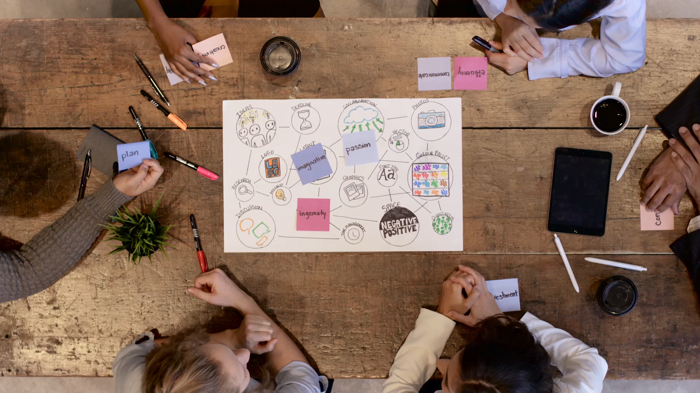
Estimating and Managing Costs in Agile Projects

Slide 2
What is Agile?
Agile is a project management methodology that focuses on iterative development and continuous improvement.
It breaks down projects into smaller, manageable pieces called sprints.
Each sprint has a defined set of goals and deliverables.
The team works closely with stakeholders throughout the project to ensure that the final product meets their needs.

Slide 3

Why Traditional Cost Estimation Doesn't Work for Agile
Traditional cost estimation methods rely on a detailed upfront project plan.
This is difficult to achieve in Agile projects, where requirements are constantly evolving.
Traditional methods also often underestimate the cost of change.
Agile projects embrace change, so it's important to factor in the cost of rework.

Slide 4
Agile Cost Estimation Techniques
There are several alternative methods for estimating costs in Agile projects.
Some popular techniques include:
Planning Poker
T-shirt sizing
Relative estimation

Slide 5
Planning Poker
Planning Poker is a popular technique for estimating effort in Agile projects.
The team uses a deck of cards with numbers on them to estimate the relative effort required to complete each user story.
Each team member plays a card face down, and then everyone reveals their cards simultaneously.
If there is a wide range of estimates, the team discusses their reasoning and then re-estimates.

Slide 6

T-shirt Sizing
T-shirt sizing is a simple technique for estimating effort in Agile projects.
The team assigns a T-shirt size (XS, S, M, L, XL) to each user story based on the relative effort required to complete it.
This is a quick and easy way to estimate effort, but it can be less precise than Planning Poker.

Slide 7

Relative Estimation
Relative estimation is a technique where user stories are estimated in relation to each other.
The team chooses a reference story and assigns it a value of 1.
All other user stories are then estimated in comparison to the reference story.
This technique can be helpful for teams that are new to Agile or that do not have a good understanding of the project scope.

Slide 8
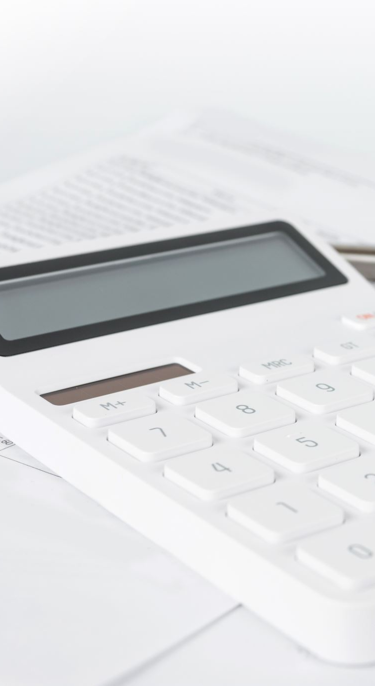
Costing Based on Effort
Once the effort for each user story has been estimated, this can be converted into a cost.
The cost per unit of effort can be calculated by dividing the total project budget by the total estimated effort.
This cost can then be used to estimate the cost of each user story.

Slide 9
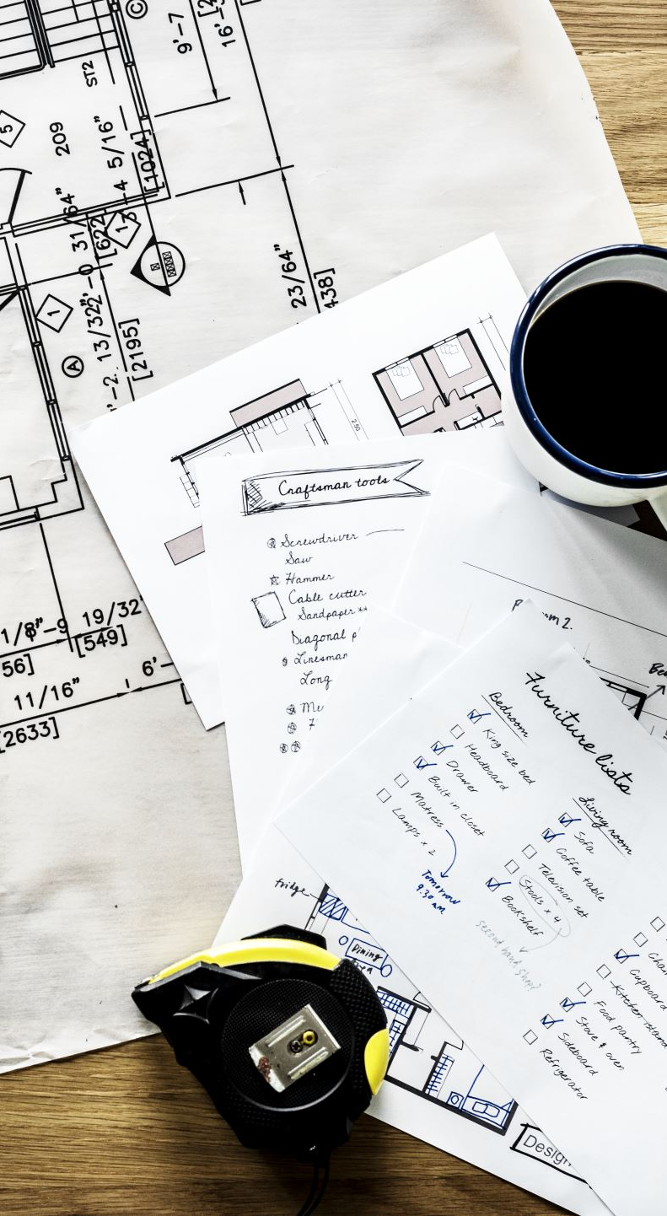
Bottom-Up vs. Top-Down Estimating
There are two main approaches to estimating costs in Agile projects:
Bottom-up estimating: This approach involves estimating the effort for each individual user story and then rolling these estimates up to get a project total.
Top-down estimating: This approach involves setting a high-level project budget and then allocating this budget to individual user stories.

Slide 10
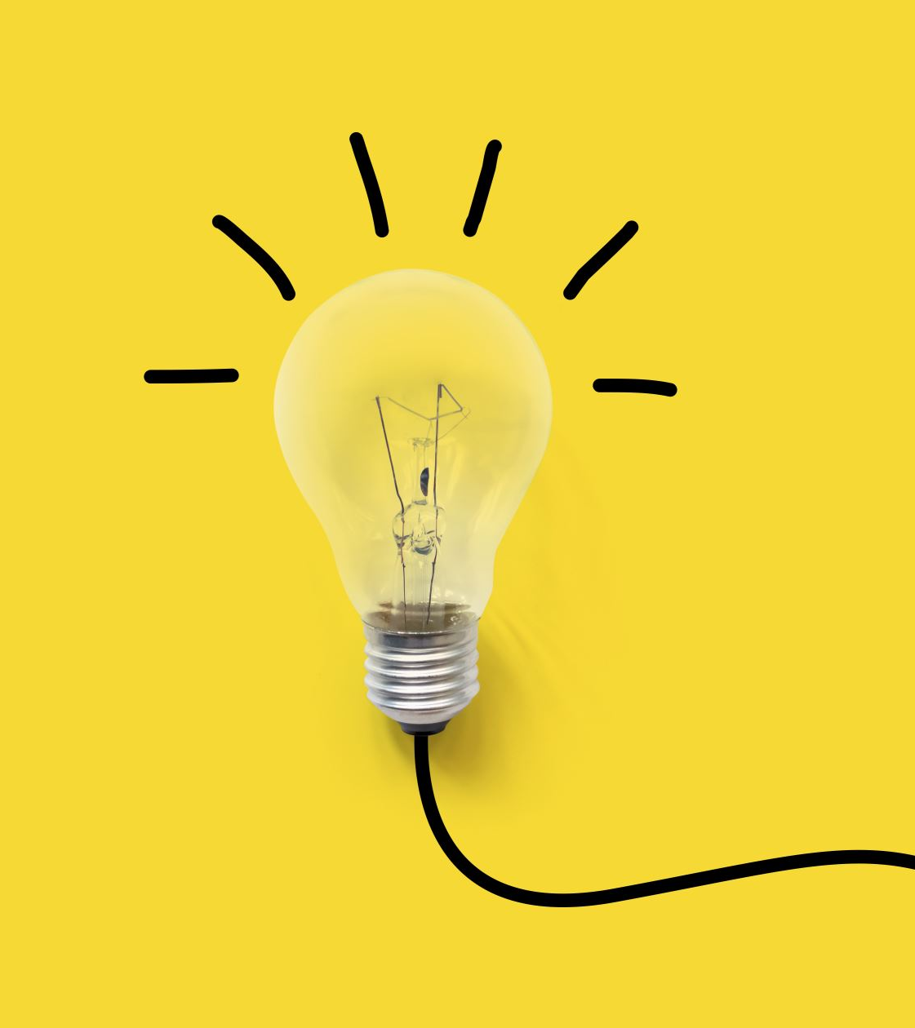
Continuous Cost Management
Agile is an iterative and incremental approach to project management, which means that costs need to be managed continuously throughout the project lifecycle.
This involves tracking actual costs against estimated costs and identifying any variances.
The team can then take corrective action to address any cost overruns.

Slide 11
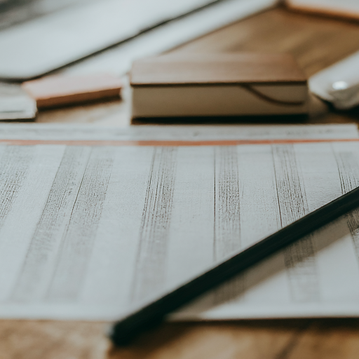
Tracking Actual Costs
It's important to track actual costs throughout the project lifecycle.
This can be done by:
Tracking team member time spent on each user story.
Tracking the cost of any external resources used.
Tracking any other project expenses.

Slide 12
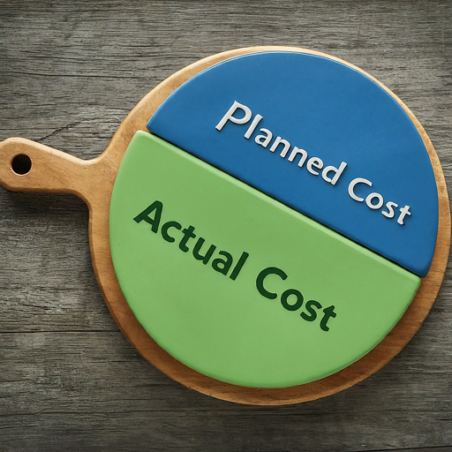
Variance Analysis
Variance analysis is the process of comparing actual costs to estimated costs.
It helps to identify areas where the project is over or under budget.
The variance can be expressed as a dollar amount or a percentage.

Slide 13


Cost Control Techniques
There are a number of cost control techniques that can be used in Agile projects.
Some common techniques include:
Prioritization: Focus on delivering the most valuable user stories first.
Velocity tracking: Track the amount of work the team can complete in each sprint.
Scope management: Carefully manage project scope to avoid scope creep.
Continuous improvement: Continuously look for ways to improve efficiency and reduce costs.

Slide 14
Prioritization for Cost Control
Prioritization is a key cost control technique in Agile projects.
The team should focus on delivering the user stories that will provide the most value to the customer first.
This will help to ensure that the project is delivering a return on investment (ROI).

Slide 15

Velocity Tracking
Velocity tracking is a technique for measuring the team's capacity to deliver work.
It is measured in story points or ideal days.
By tracking velocity, the team can forecast how much work they can complete in future sprints.
This information can be used to help with budgeting and planning.

Slide 16
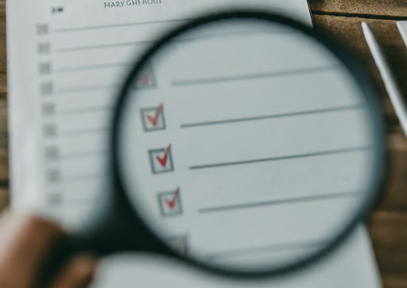
Scope Management for Cost Control
Scope creep is a major risk to project budgets in Agile projects.
Scope creep occurs when new features or functionality are added to the project after the initial scope has been defined.
Scope management is the process of controlling project scope to avoid scope creep.

Slide 17
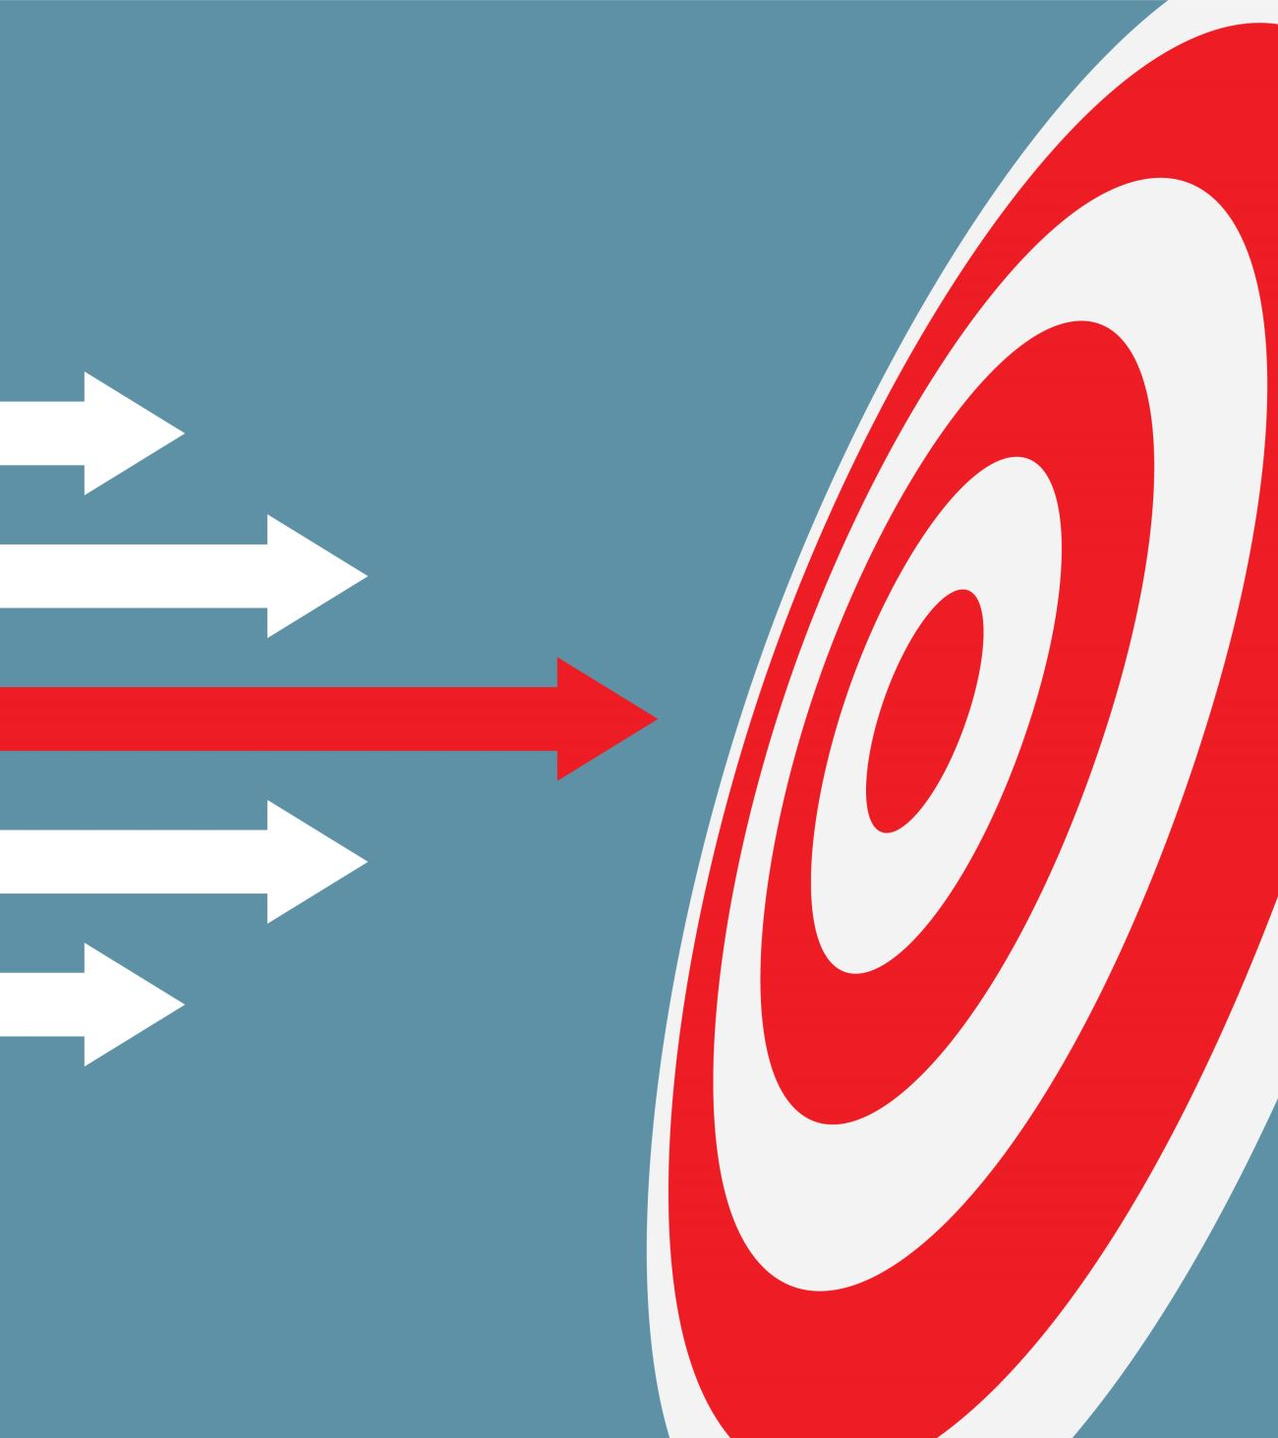
Continuous Improvement
Continuous improvement is a core principle of Agile.
It means that the team is always looking for ways to improve their processes and deliver value more efficiently.
By continuously improving, the team can reduce costs and improve project outcomes.

Slide 18
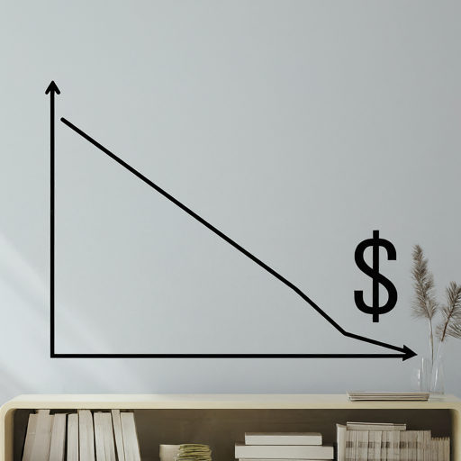
Cost Management Benefits
There are a number of benefits to effectively managing costs in Agile projects.
Some of the benefits include:
Improved project predictability: By accurately estimating and managing costs, the team can improve the predictability of project outcomes.
Increased project transparency: By tracking actual costs and variances, the team can increase project transparency and accountability.
More efficient resource allocation: By understanding project costs, the team can make more efficient decisions about how to allocate resources.
Improved stakeholder satisfaction: By delivering projects on budget, the team can improve stakeholder satisfaction.

Slide 19
Challenges in Agile Cost Management
Changing Requirements: Agile projects often face challenges due to evolving requirements, leading to uncertainty in cost estimation and control.
Resource Constraints: Limited resources, such as skilled team members or budgetary constraints, can impact cost management efforts in Agile projects.

Slide 20

Best Practices
Iterative Refinement: Continuously refine cost estimates and control measures based on feedback and lessons learned from previous iterations.
Collaborative Decision Making: Involve all stakeholders in cost management activities, fostering collaboration and shared ownership of project costs.
Example Scenario: Highlight best practices such as regular retrospective meetings to reflect on cost management practices and identify areas for improvement.

Slide 21
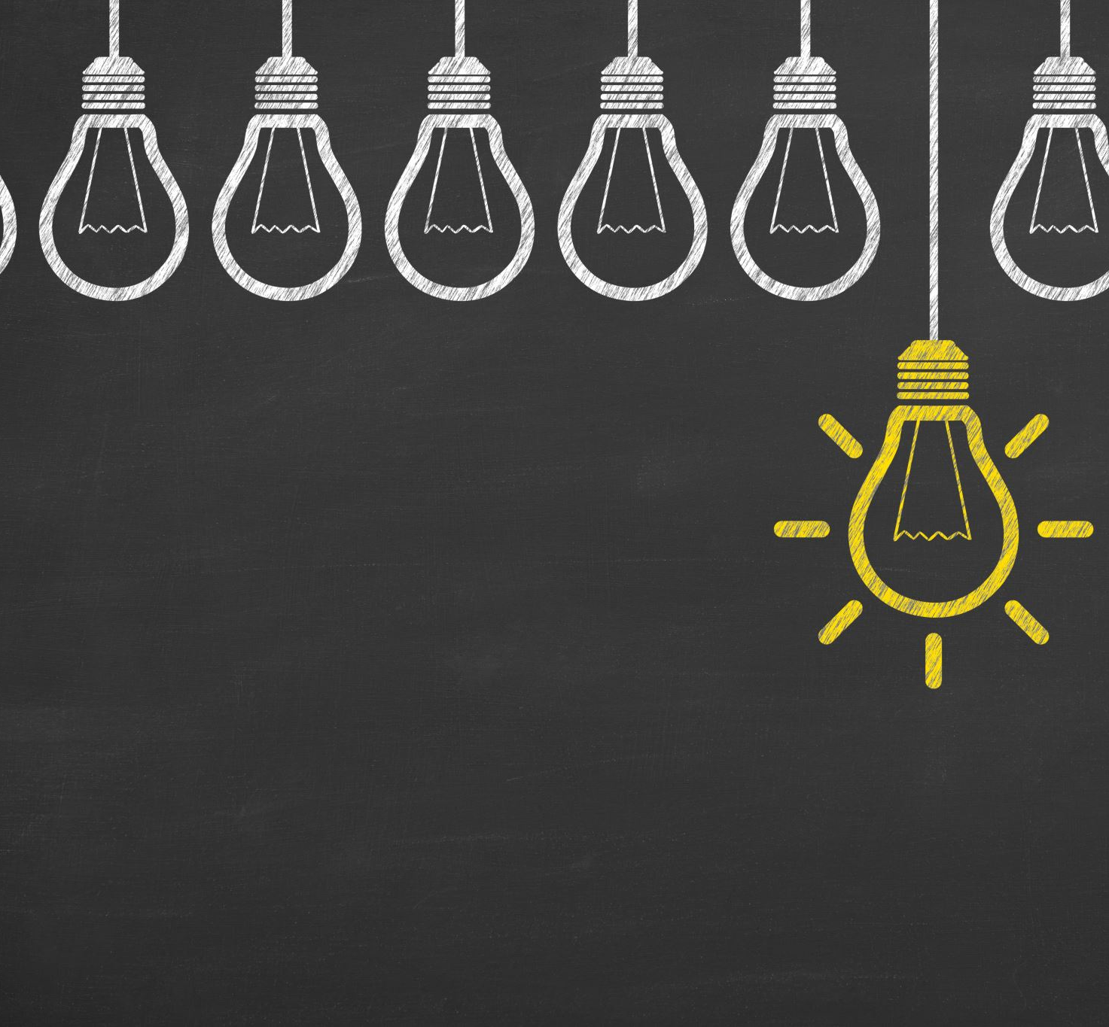
Conclusion
Agile cost estimation and management is an iterative process.
It requires collaboration between the product owner, the development team, and all other stakeholders.
By following the techniques outlined in this presentation, teams can effectively estimate and manage costs in Agile projects.

Slide 22

Q&A

